Slide 1
Advancing the Equity Agenda: Setting an Equity-Minded Attainment Goal and Eliminating Disparities
Board of Higher Education Meeting | February 4, 2020

Slide 2
Equity in Action BHE is 1st System Board in U.S. to elevate equity as #1 policy & performance priority

Slide 3
A Bold Equity Goal: Attainment
Advancing the Equity Agenda
TODAY
In Massachusetts
53.8% hold associate degree or higher
3% hold high-quality credential
GOAL
By 2030, 70% of MA residents ages 25-64 will hold postsecondary credentials
60% associate degree and above
10% high-quality credential

Slide 4
Goal for Eliminating Disparities
Advancing the Equity Agenda
TODAY
Fall 2011 Attainment Levels in MA Public Higher Education
42.2% for African American students
39.6% for Latinx students
63% for White students
GOAL
Reduce disparities between White/ African American students & White/Latinx students by 25% in four years.

Slide 5
Key Structures of the Equity Agenda
Advancing the Equity Agenda

Slide 6
Key Structures of the Equity Agenda
Advancing the Equity Agenda

Slide 7
Key Structures of the Equity Agenda
Advancing the Equity Agenda

Slide 8
Key Structures of the Equity Agenda
Advancing the Equity Agenda

Slide 9
Key Structures of the Equity Agenda
Advancing the Equity Agenda

Slide 10
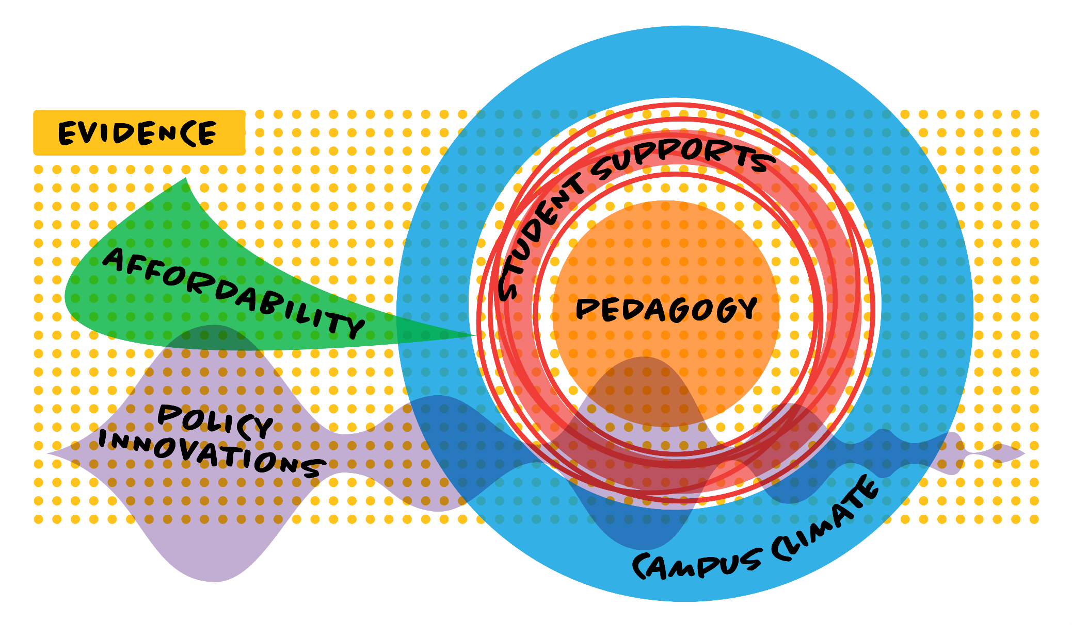
Key Structures of the Equity Agenda
Advancing the Equity Agenda

Slide 11
FY21 Budget Supports Equity Goals
Advancing the Equity Agenda
Evidence: Ongoing Funding for Performance Measurement Reporting System (PMRS)
Pedagogy: Higher Ed Innovation Fund
Student Supports: Through Formula Funding
Campus Climate: Funding for Systemwide Survey through Higher Ed Innovation Fund
Affordability: Increase for MassGrant Plus Program
Policy Innovations: Increase for Early College

Slide 12
To Meet Goals, Race Matters…
Advancing the Equity Agenda
What percentage of first-time, full-time students who initially enrolled at a Massachusetts public college or university in fall 2011 earned a degree anywhere within six years?

Slide 13
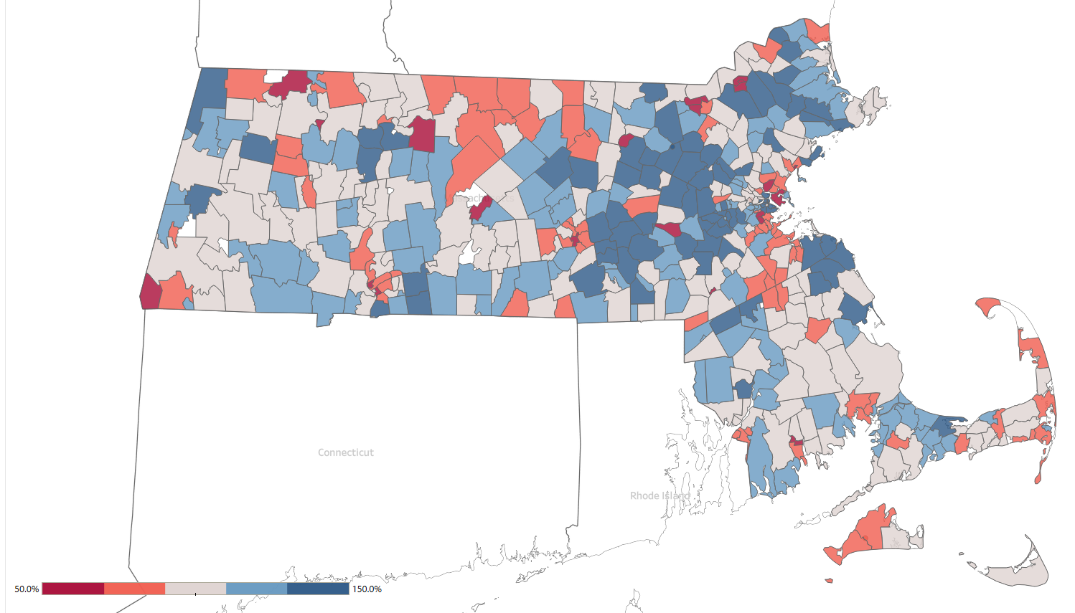
…and Zip Code Matters.
Advancing the Equity Agenda
ZIP Code Median Earnings as % of County Median Earnings

Slide 14
Timeline
Advancing the Equity Agenda
March 2020: BHE Vote on Goals
Late Spring 2020: Strategic Planning Process Begins (BHE Retreat)
October 2020: Budget aligned with Equity Goals
March 2021: One-year update on progress made toward reaching goals

Slide 15
Key to Success: New Thought Paradigm
Advancing the Equity Agenda
Deficit Model
Asset-Based Model
Students Are Not Ready for College
Campuses Are Ready for Students

